Slide 1
Perception

Slide 2
Sensation and Perception
Sensation
The process through which the senses pick up visual, auditory, and other sensory stimuli and transmit them to the brain; sensory information that has registered in the brain but has not been interpreted
Perception
The process by which sensory information is actively organized and interpreted by the brain
Notes:
2
2

Slide 3
Perception
Gestalt principles of perceptual organization
Figure-ground
Organization depends on what we see as figure (object) and what we perceive a ground (context).
Similarity
Objects that have similar characteristics are perceived as unit.
Notes:
2
2

Slide 4
Proximity
Objects close together in space or time perceived as belonging together.
Continuity
We tend to perceive figures or objects as belonging together if they appear to form a continuous pattern.
Closure
We perceive figures with gaps in them to be complete.

Slide 5

Perception
You can see a white vase as figure against a black background, or two black faces in profile on a white background
Notes:
2
2

Slide 6
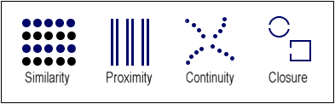

Slide 7
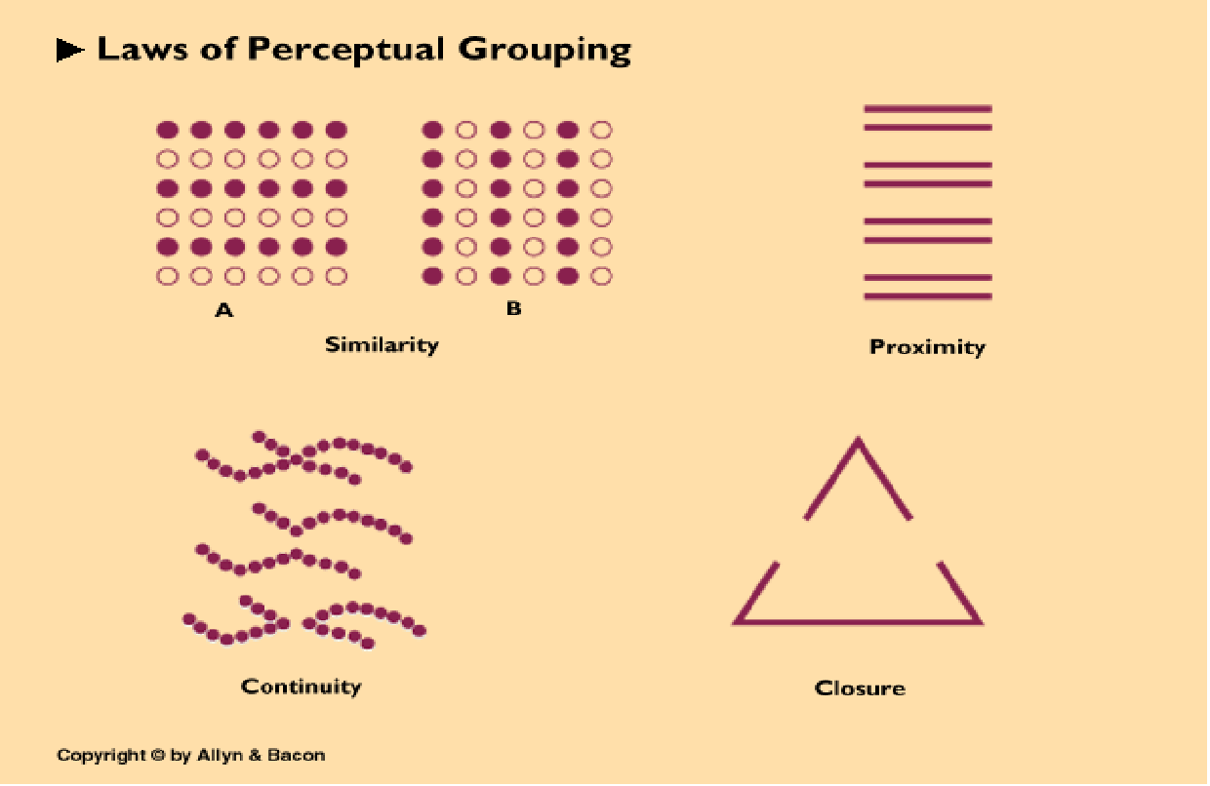
Notes:
2
2

Slide 8
Depth Perception
Depth perception
The ability to see in three dimensions and to estimate distance
Monocular depth cues
Depth cues that can be perceived by only one eye
Notes:
2
2

Slide 9
Perception
Monocular depth cues
Types of cues
Motion parallax
When you ride in a moving vehicle and look out the side window, the objects you see outside appear to be moving in the opposite direction
Objects seem to be moving at different speeds – those closest to you appear to be moving faster than those in the distance
Objects very far away, such as the moon and the sun, appear to move in the same direction as the viewer
Notes:
2
2

Slide 10
Perception
Binocular depth cues
Depth cues that depend on two eyes working together
Convergence
Occurs when the eyes turn inward to focus on nearby objects – the closer the object, the greater the convergence
Notes:
2
2

Slide 11
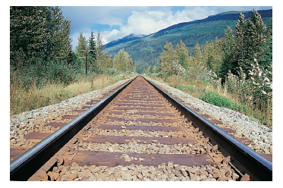

Slide 12
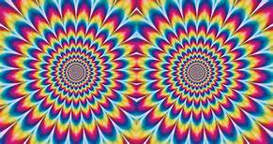
Motion Perception

Slide 13
Perception
Ambiguous figures
Can be seen in different ways to make different images
Best known ambiguous figure is “Old Woman/Young Woman,” by E. G. Boring
Notes:
2
2

Slide 14
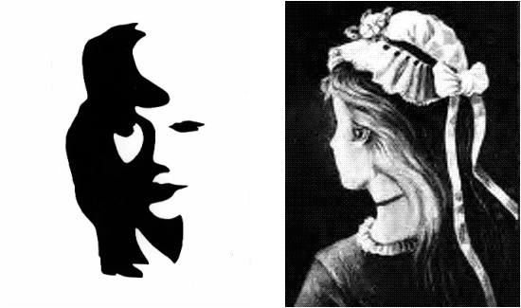

Slide 15
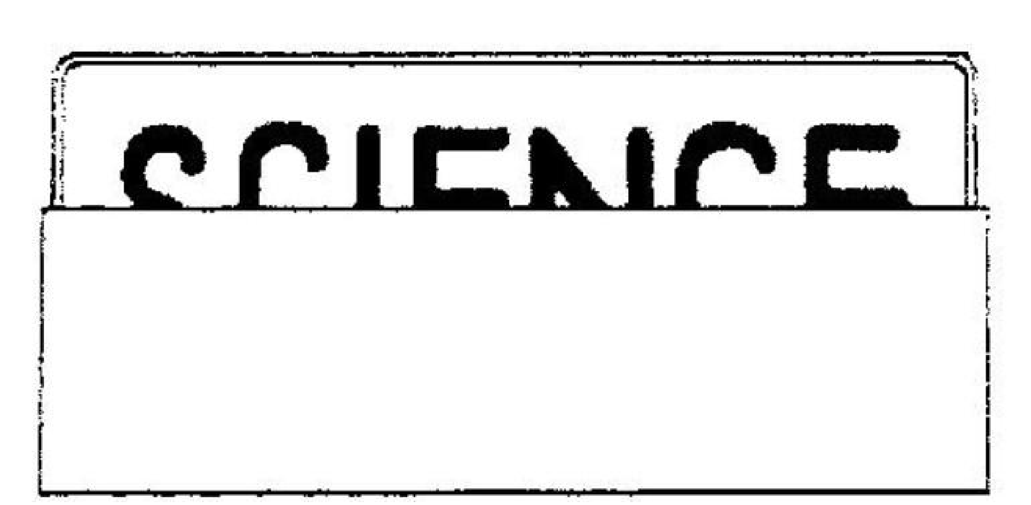
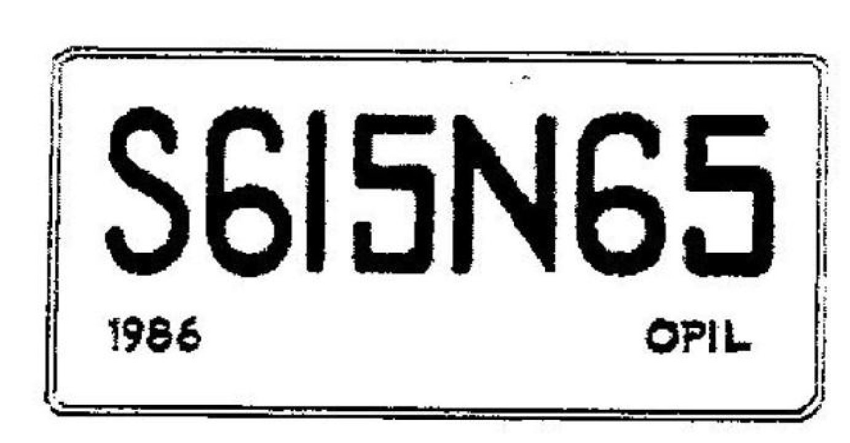
What do you see?
Now what do you see?
Copyright © Allyn & Bacon 2005
Notes:
2
2

Slide 16
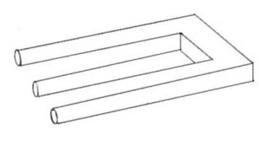

Perception
Impossible figures
Do not seem unusual at first
Figures that cannot be built
Notes:
2
2

Slide 17
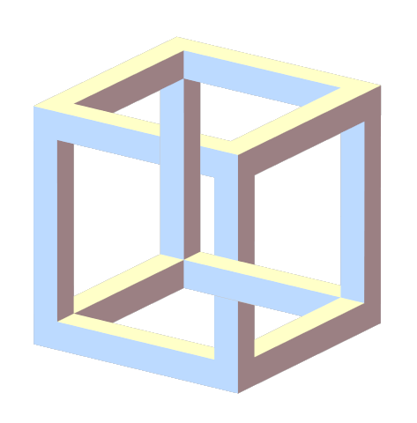
Notes:
2
2

Slide 18
Illusion
A false perception of actual stimuli involving a misperception of size, shape, or the relationship of one element to another
Notes:
2
2

Slide 19
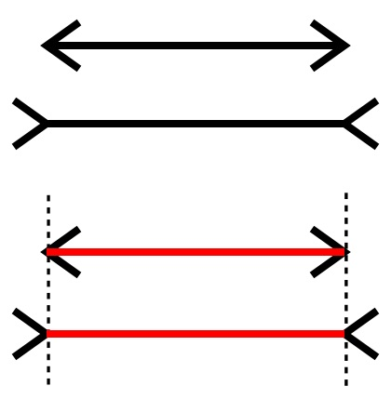
Müller-Lyer Illusion
The two lines above are the same length, but the diagonals extending outward from both ends of the lower line make it look longer than the upper line
Notes:
2
2

